Slide 1

Project 4: Using Machine Learning to Increase Oil Rig Productivity
Olivia Bedford, Chibuzor Ejiaga, & Juan Sierra

Slide 2
Contents:
Research Questions
Introduction to terms and methods
Data cleaning & organization
Overview of data
Model testing
Tableau visualizations

Slide 3
Research questions:
What is the rig state in a given period of time?
What percentage of time has been spent in the given time frame?
What is the effective time spent drilling vs. other operations?
How much time is spent in rotating drilling vs. slide drilling?

Slide 4
Defining terms:
Rig state: Generally understood as referring to what stage in the process of oil drilling a rig is engaged in during a given period of time. IADC provides a list of 34 possible rig states in order to standardize procedures.
Slide drilling: The drill is stationary except for a small rotary motor at the very end of the drill bit, used to bore down through the well.
Rotary drilling: The entire drill bit is rotating down through the earth at a steady RPM from a top-driven motor.

Slide 5
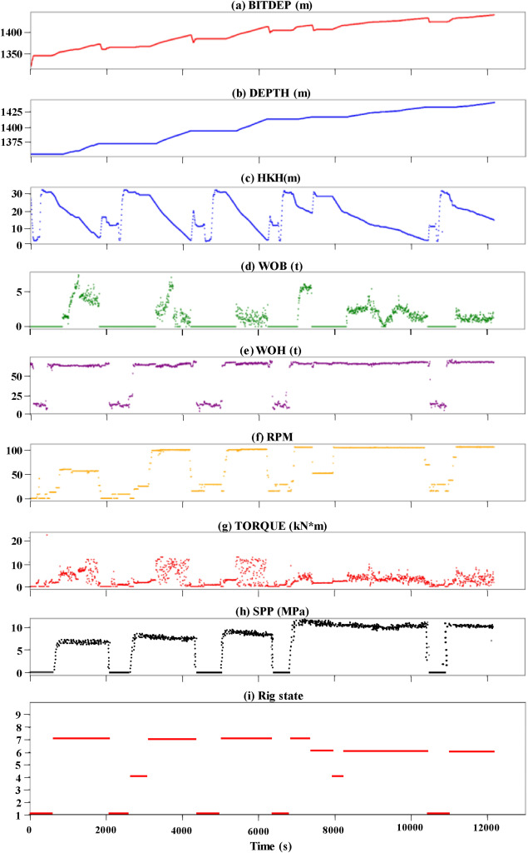
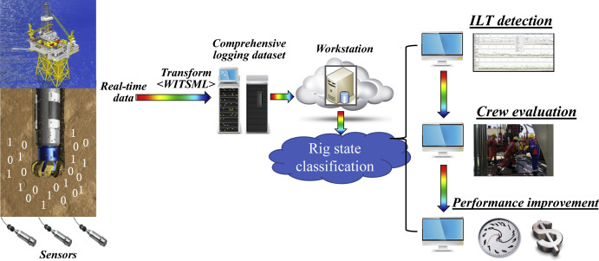
What is rig state classification?

Slide 6
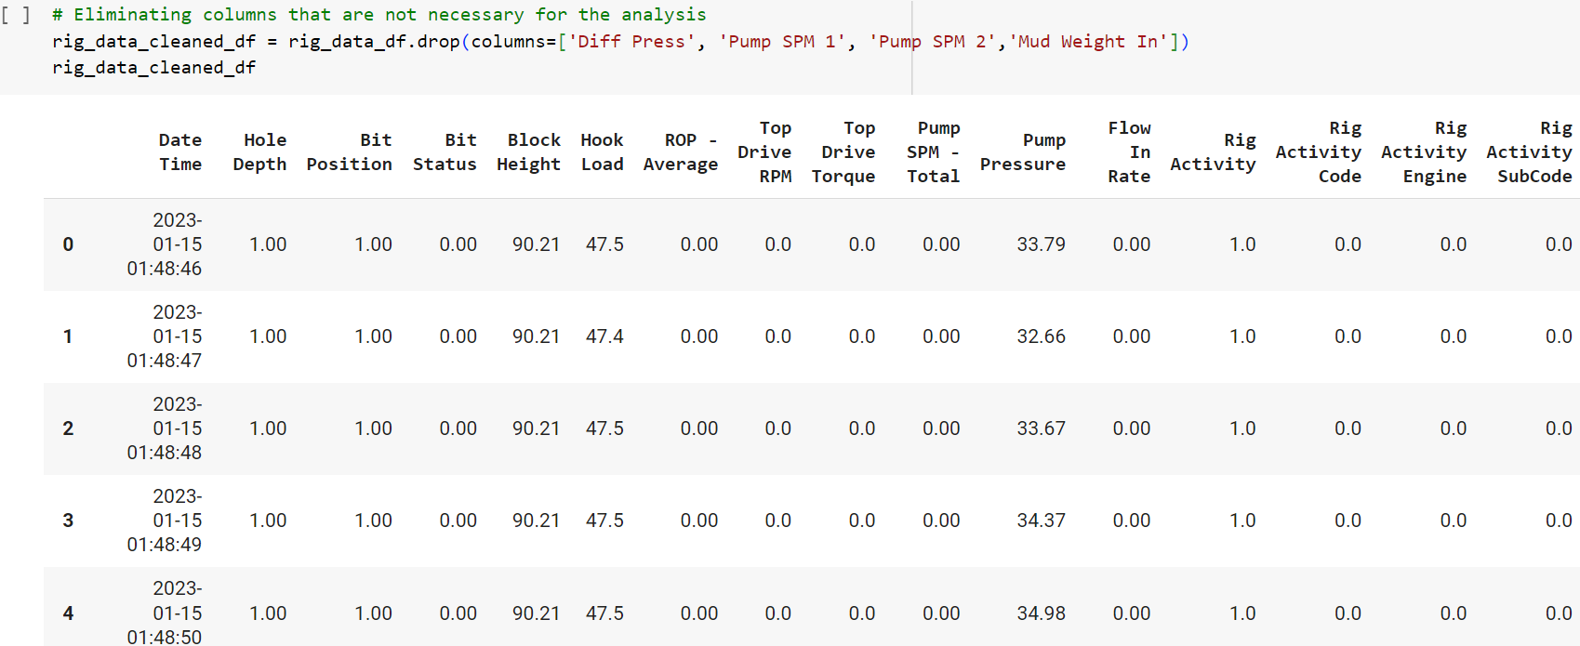
Data Cleaning & Organization

Slide 7
Data cleaning steps:
Eliminate columns with data irrelevant to the research
Eliminate null data points
Eliminate impossible negative values and spurious data points
Eliminate rig state codes which are not in line with IADC standard code

Slide 8
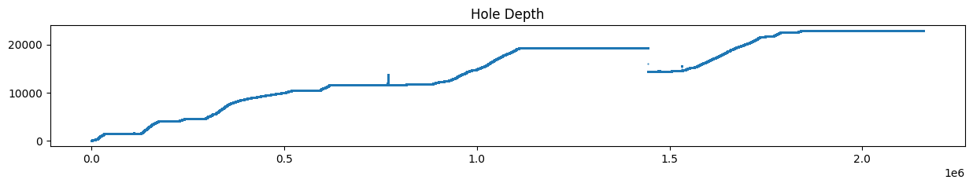
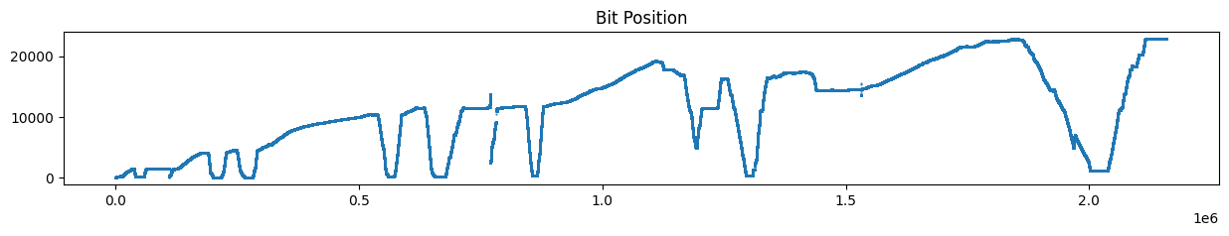
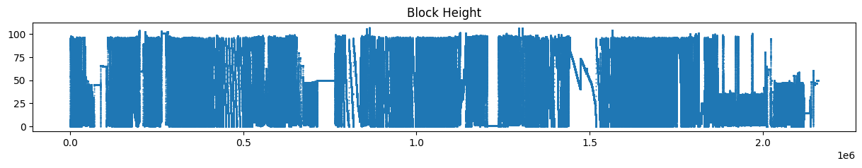
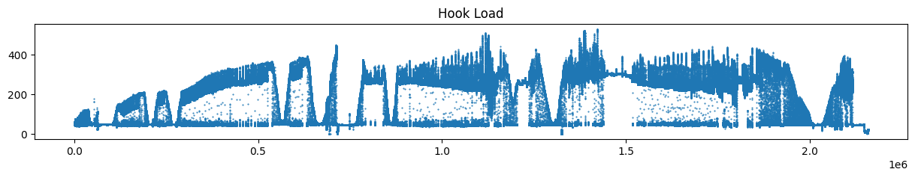
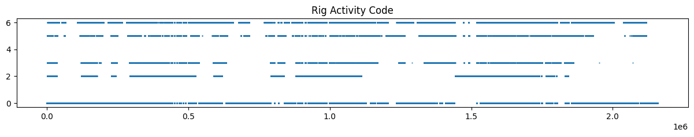

Slide 9
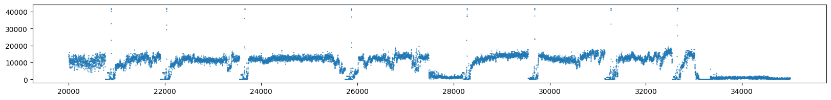
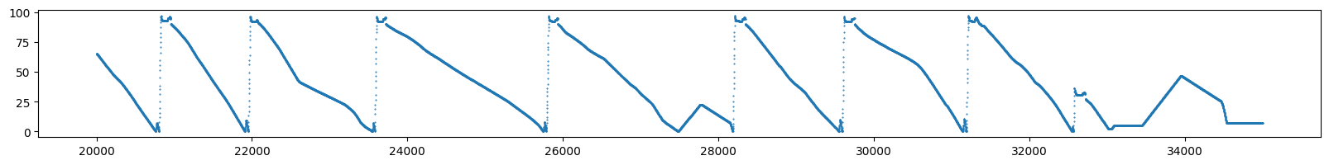
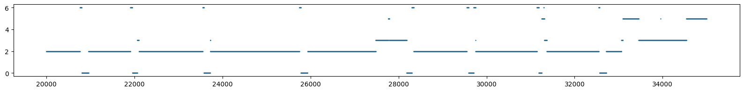
Top drive torque, block height, & rig activity code:

Slide 10
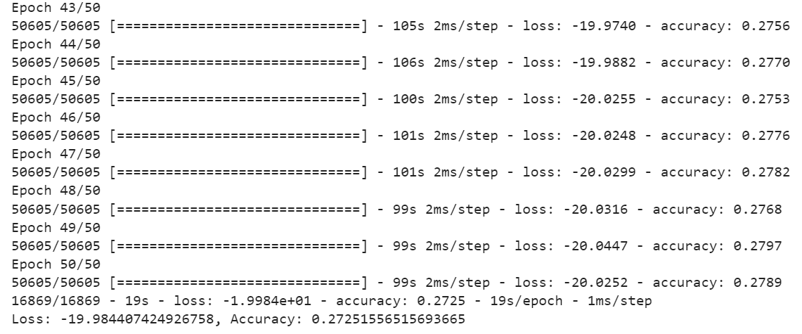
Model testing: Neural Network

Slide 11
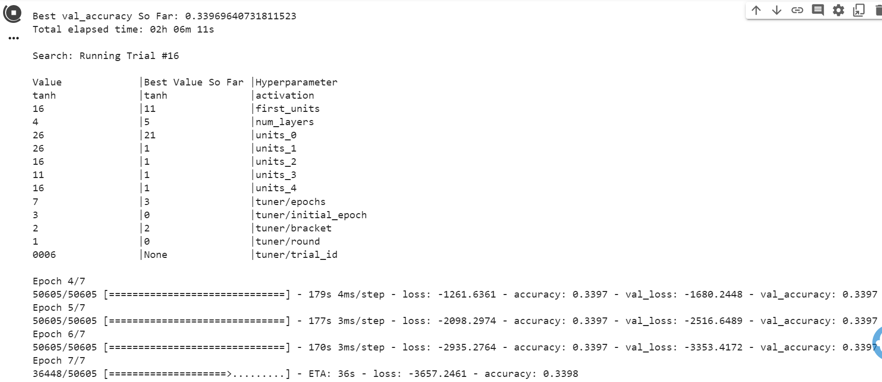
Model testing: Keras Tuner

Slide 12
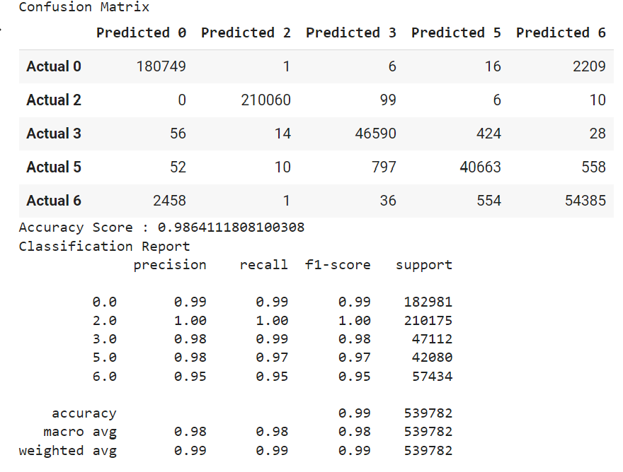
Model testing: Random Forest

Slide 13
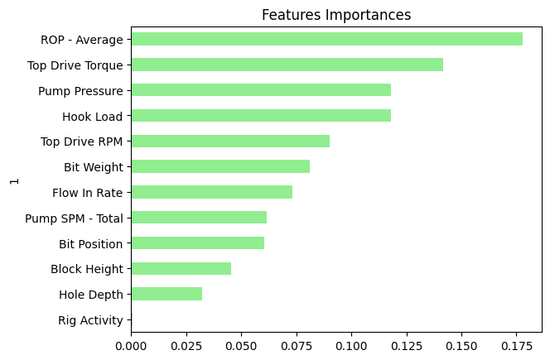
Feature importance
# Define features set
X = df.copy()
X.drop("Rig Activity Code", axis=1, inplace=True)
X.drop("Rig Activity SubCode", axis=1, inplace=True)
X.drop("Rig Activity Engine", axis=1, inplace=True)
X.drop("Bit Status", axis=1, inplace=True)
X.drop("Date Time", axis=1, inplace=True)

Slide 14
Tableau Visualizations:
Link: Final Project 4 | Tableau Public

Slide 15

Thank you!

